Slide 1

Machine Learning-Based Detection of Cardiovascular Diseases

Slide 2

Dr. Nasir Ahmad Project Supervisor
Engr. Naina Said Project Advisor
Mian Inshaullah
Fakeha Saeed
Sana Sikandar
Javeria Waheed

Slide 3


Introduction
Heart Diseases are the leading cause of deaths worldwide, they account for 32% of all global deaths and they are the leading cause of deaths in Pakistan
In Pakistan, Cardiovascular Diseases account for 29% of all deaths, according to data from WHO.
Pakistan ranks 18th in the world with a death rate of 238 per 100,000 population from cardiovascular diseases.

Slide 4
Introduction
Middle-income countries like Pakistan suffer a lot from cardiovascular diseases because minimal attention is given to the detection, prevention, and precaution of the risk factors of cardiovascular diseases.
Moreover, the increasing economic and political instability prevalent in South Asian countries catalyzes the rate of cardiovascular diseases in the region.
Research shows that South Asian populations have one of the highest risks of cardiovascular diseases in the world.

Slide 5
Introduction
Early detection of cardiovascular diseases can greatly suppress fatalities. Through early diagnosis of patients can take preventive measures.
About 68.5% of Doctors and Practitioners misdiagnose Heart Diseases.
Misdiagnosis of Heart Diseases can be attributed to misreading electrocardiograms.

Slide 6

Problem Statement
How to successfully identify the prevalence of Cardiovascular diseases in electrocardiograms at a low cost and high accuracy?

Slide 7

Literature Review (Overview)
We reviewed over 42 research papers. According to studies, Convolutional Neural Network is dominantly observed as the suitable technique for training a machine learning model for detecting CVDs.
About 52% of studies employed a CNN model or a variation of an CNN model such as AB-CNN, CNN-LSTM etc. to detect irregularities in the ECG signal
Because ECG signals are low-frequency and weak electrical signals that are extremely vulnerable due to the influence of external noise, one of the biggest challenges is not training the model, but denoising the EC signal and getting accurate data.

Slide 8

Literature Review (Top Methodologies)
Publication | Dataset | Method | Accuracy | Limitation
Yan, Zhang, 2021 | MIT-BIH ECG Dataset | Denoised the ECG signals using WT. Extracted features and fed into SVM. | Classified six classes of ECG signals with 96.3% accuracy. | Computationally Expensive and slow compared to other methods
Mehmet et al., 2021 | MIT-BIH ECG Dataset, PTB ECG Dataset, INCART dataset | Multi-level features were generated using HIT pattern and MAP decomposer and then fed into SVM to classify chose | Attained 92.95% and 97.18% accuracy for seven- and four- class arrythmia classification, respectively. | Although it’s computationally lightweight with a low time burden, it has low accuracy.
Wu et al., 2021 | MIT-BIH ECG Dataset | Denoised the ECG signals using WT and then fed it into CNN. | Attained 97.41% accuracy
Albadvi et al., 2021 | MIT-BIH ECG Dataset | FIR band-pass filter to filter and eliminate noise from QRS complex of ECG signals. Multiclass Random Forest model was developed and data was streamed in real time. | Attained 88.6% accuracy and average consumption time of 1 second. Only detected 3 types of cardiac arrhythmia. | Very low accuracy, computational expensive, and not as effective in denoising.

Slide 9

Literature Review (Limitations)
High accuracy was obtained by overfitting or only filtering out the QRS complex.
Size of Dataset was kept small to obtain high accuracy
Most proposed models are computationally intensive with huge memory footprint (at least 16 GB RAM is required to train the data)
Proposed DL methods were effective for limited number of Arrhythmia classes.
Publications were heavily focused on ECG signal characteristics, and not focused on patients’ physical state

Slide 10

Proposed Methodology
After studying numerous publications and studies, we’ve decided to take a research-driven approach towards processing the signals and training our model.
Seeing how successful the CNN model was, We plan to implement an Attention-based CNN model
To denoise our data, we’ll be using wavelet transform, and other denoising methods.
We also plan to use GAN and multiple datasets to avoid overfitting and gain a larger dataset.

Slide 11
Proposed Methodology
We aim to use a less computationally expensive method to predict and classify cardiovascular diseases from the respective datasets.
Our model will extract features from an ECG signal and classify various types of Heartbeats such as:
Normal Heartbeat (N),
Ventricular Fibrillation(V),
Atrial Fibrillation (A),
Right bundle branch Block(R),
Left bundle branch Block(L)
We will deploy a m

Slide 12

Proposed Methodology
We will deploy a Machine learning model to a web app to accurately detect patient ECG signals for the prevalence of Cardiovascular diseases.
Our Web App will help patients with:
Connecting with Cardiologists near them
Scan their ECGs for CVDs
Take preventive measures

Slide 13

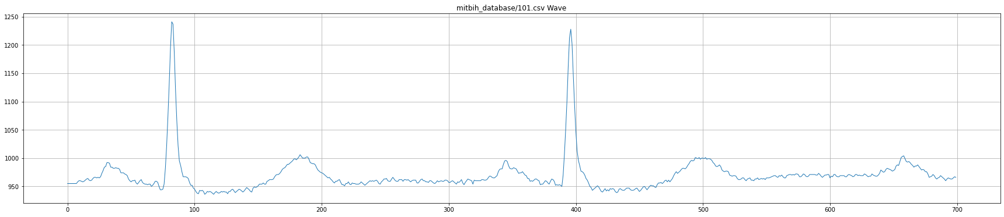
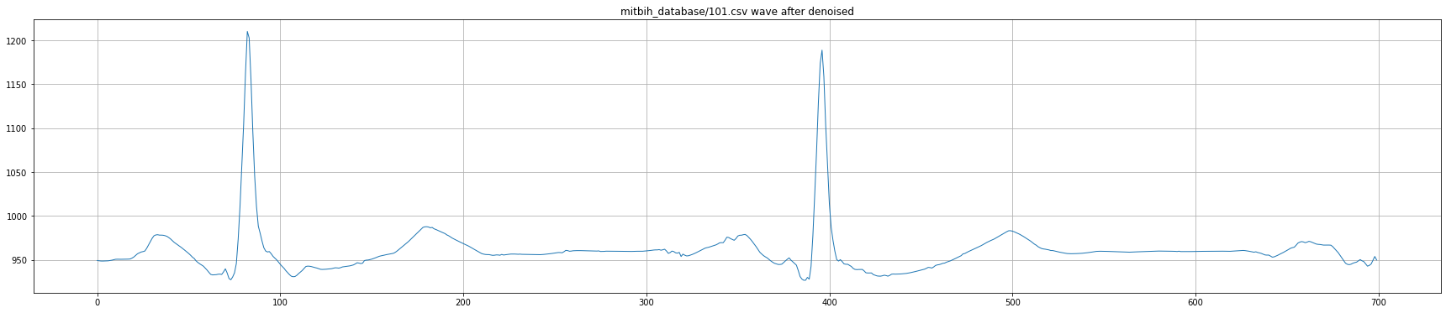
Results (Denoising of Signals)

Slide 14
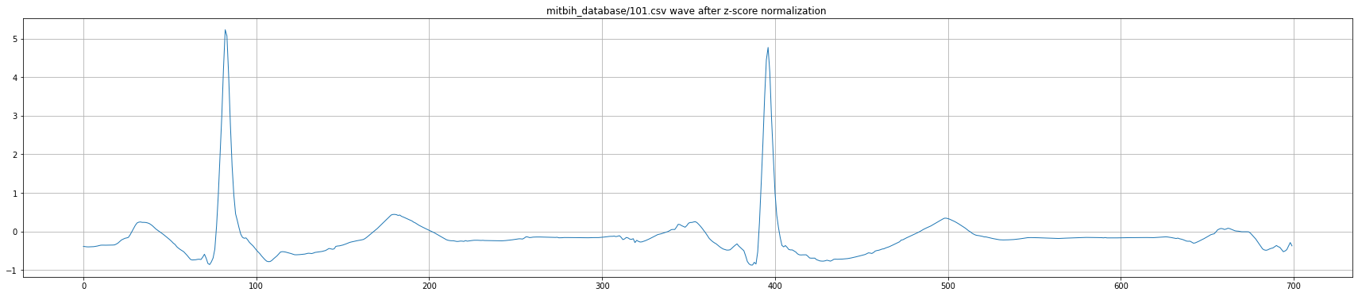
Results (Denoised Signal)

Slide 15
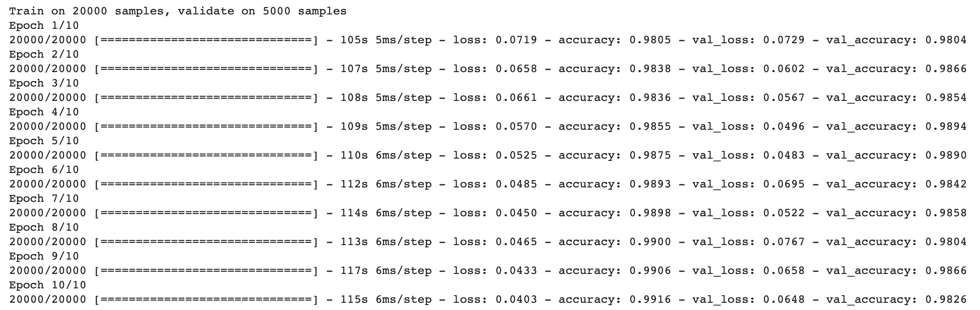
Results (Accuracy)
10 Epochs
20 Epochs

Slide 16
Results (Accuracy)
40 Epochs
60 Epochs

Slide 17
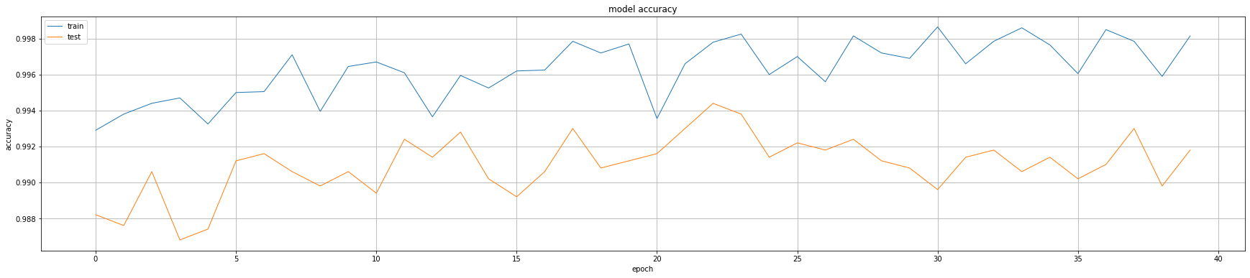
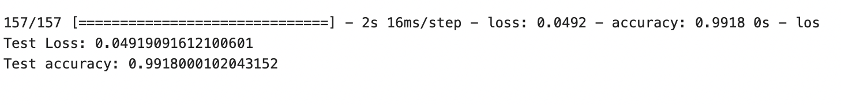
Results (Tested Accuracy)

Slide 18
Web App Demo

Slide 19

The End Thank You

